Slide 1
IMAGE CAPTIONING
PRESENTED BY: MANAN CHAUHAN
GUIDED BY: SAURAV KUMAR

Slide 2
CONTENT
Objective
Dataset Review
Pre-Processing
Data Generation
Architecture
VGG-16
Long Short Term Memory
Model Evaluation
Results
Conclusion

Slide 3
OBJECTIVE
Develop a robust image captioning model that can generate accurate and descriptive captions.
Potential Applications:
Aiding visually impaired
Generating video summary using individual frames

Slide 4
DATASET REVIEW
The Flickr8k dataset serves as a benchmark for sentence-based image description and retrieval. It includes:
•8,091 Images: Each image is paired with five distinct captions.
•Image Sources: Images are sourced from six different Flickr groups, depicting a diverse range of scenes and scenarios.
•Content Focus: The images intentionally exclude well-known people or landmarks to emphasize general scene descriptions.

Slide 5
PRE-PROCESSING
Convert all text to lowercase.
Remove all non-alphabetic characters.
Remove whitespaces.
Add “startseq” at the start of the text and “endseq” at the end (helps in predicting the captions).

Slide 6
DATA GENERATION
Data gets split in input and output pairs.
Captions get encoded in sequence.
Sequences stored.

Slide 7
ARCHITECTURE
VGG-16: The VGG-16 configuration typically consists of 16 layers, including 13 convolutional layers and 3 fully connected layers. The VGG-16 configuration typically consists of 16 layers, including 13 convolutional layers and 3 fully connected layers. Here we it is used for feature extraction from the images.
LSTM: LSTM networks are an extension of recurrent neural networks, the hidden layer of LSTM is a gated unit/cell. Information is retained by the cells and the memory manipulations are done by the gates. There are three gates Forget Gate, Input Gate Output Gate. Here we used the LSTM takes the image features and previously generated tokens as input to predict the next word in the caption.

Slide 8
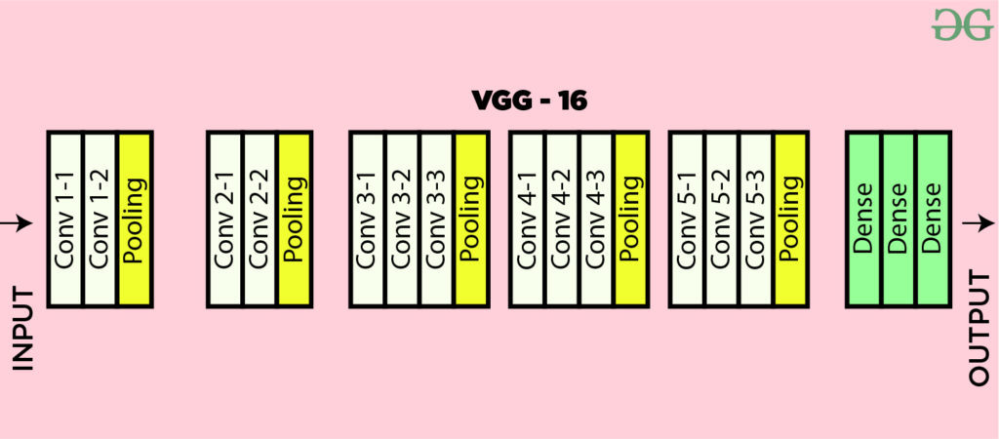
VGG-16
Pre-trained VGG-16 model, trained with imagenet dataset.
No output layer, only needed for feature extraction (bottleneck features).
Resizing Image because VGG-16 only accepts size 224x224.

Slide 9
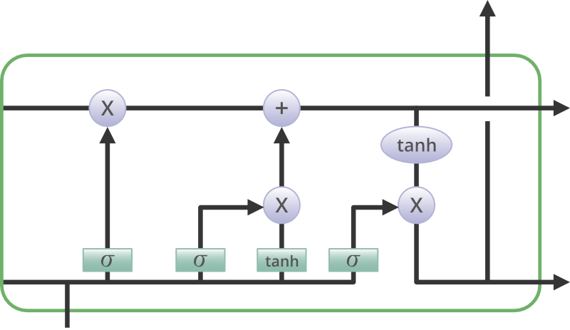
LONG SHORT TERM MEMORY(LSTM)
Features extracted from bottleneck VGG-16 to LSTM to train the model in predicting the captions.
The pre-processed data gets decoded and trains the model in generaton of caption.
Caption gets generated one word after other in a sequence.

Slide 10
MODEL EVALUATION
BLEU-1: 0.545007
BLEU-2: 0.317127
The BLEU scores indicate that the model generates captions with a reasonable level of accuracy, capturing key words and some context, but there is still room for improvement in generating more fluent and contextually rich captions

Slide 11
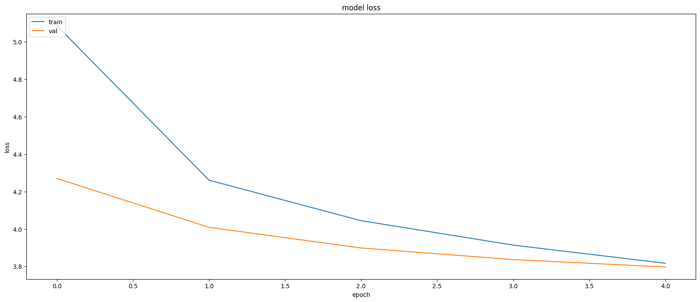
RESULTS
Learning Curve

Slide 12
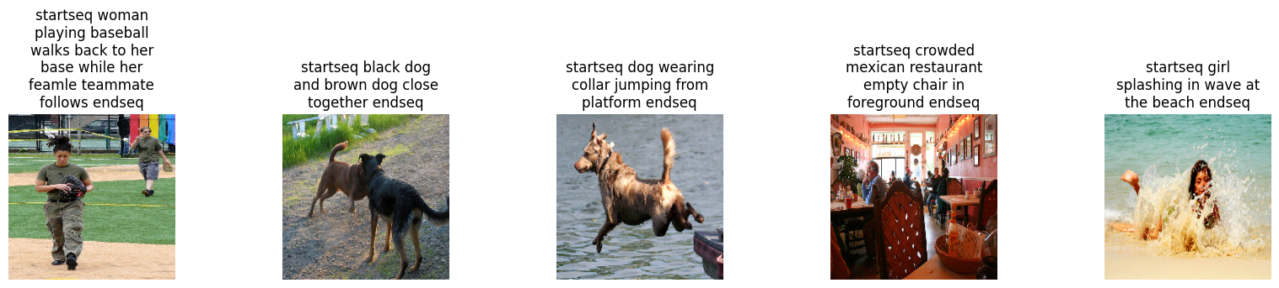
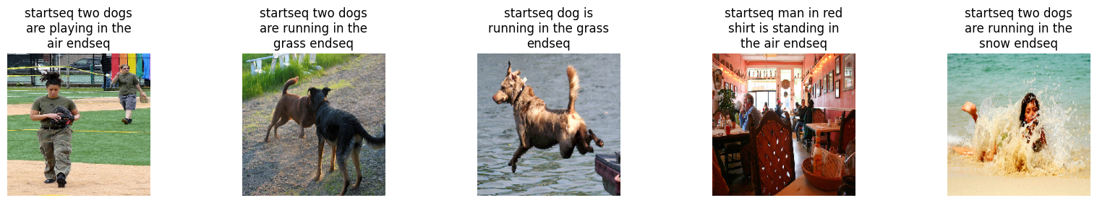
Actual
Predicted

Slide 13
CONCLUSION
The model is able to generate captions and can be enhanced with more epochs and larger datasets Eg. Flickr32k that has 32000 images.

Slide 14
THANK YOU

